Slide 1
In Secure Web Applications

Slide 2

Me
Denny Headrick
@dennythecoder
denny.headrick@gmail.com

Slide 3
Me
npm i denny

Slide 4
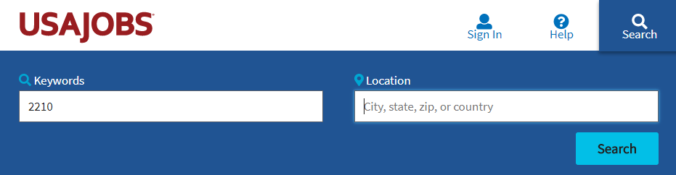
USAJOBS.GOV
Search for 2210 || 1550

Slide 5
You

Slide 6
You
It’s okay to answer more than once

Slide 7
You
It’s okay to answer more than once
Front-End

Slide 8
You
It’s okay to answer more than once
Back-End

Slide 9
You
It’s okay to answer more than once
DBA

Slide 10
You
It’s okay to answer more than once
DBA

Slide 11
You
It’s okay to answer more than once
Environment

Slide 12
Good News

Slide 13
Bad News

Slide 14
Bad News
I was lying

Slide 15
About the OWASP Top 10
OWASP Top 10 is an Awareness Document
Not a standard…
First developed in 2003
Was probably 3rd or 4th OWASP project, after
Developers Guide
WebGoat
Maybe WebScarab ??
Released
2003, 2004, 2007, 2010, 2013, 2017

Slide 16
Integrity
Confidentiality
Availability

Slide 17
Integrity
Confidentiality
Availability

Slide 18
Integrity
Confidentiality
Availability

Slide 19
Integrity
Confidentiality
Availability

Slide 20
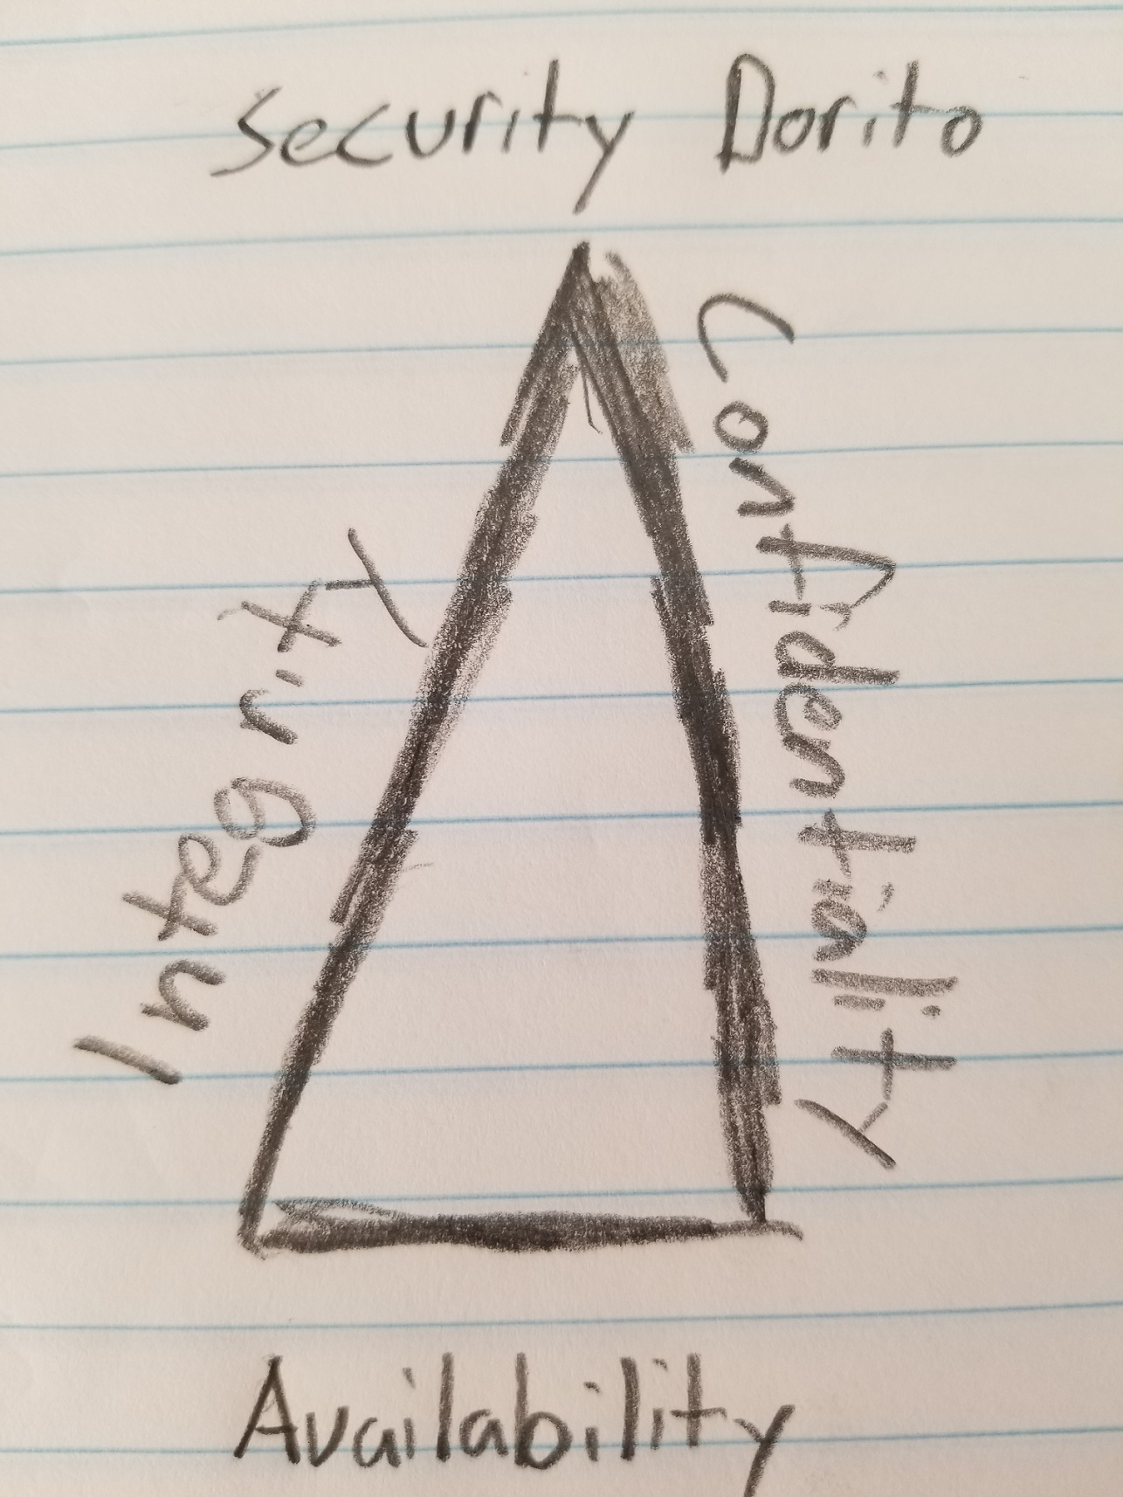

Slide 21
Delicious!

Slide 22
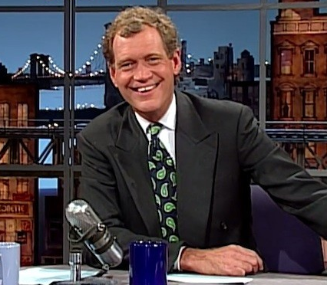
Top Ten Security Vulnerabilities

Slide 23
10

Slide 24
10 – CSRF

Slide 25
Makes users do bad things

Slide 26
Makes users do bad things
..or annoying things

Slide 27
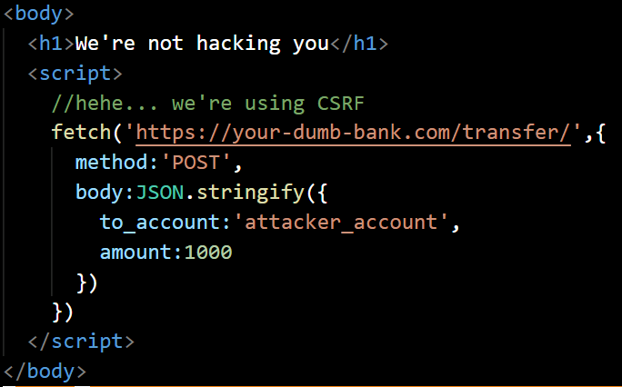

Slide 28
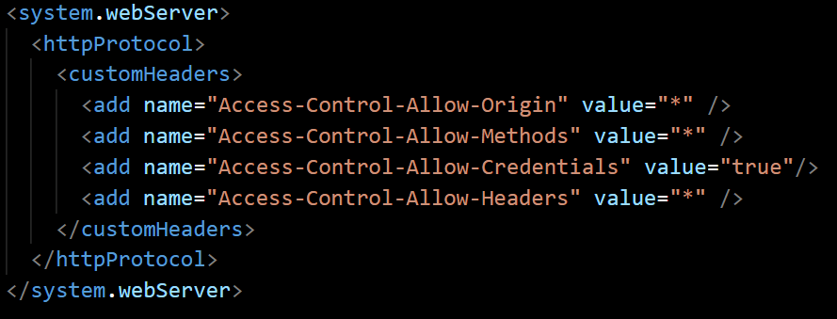

Slide 29
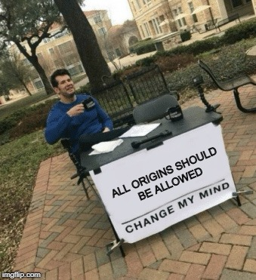

Slide 30
Disallow CORS

Slide 31
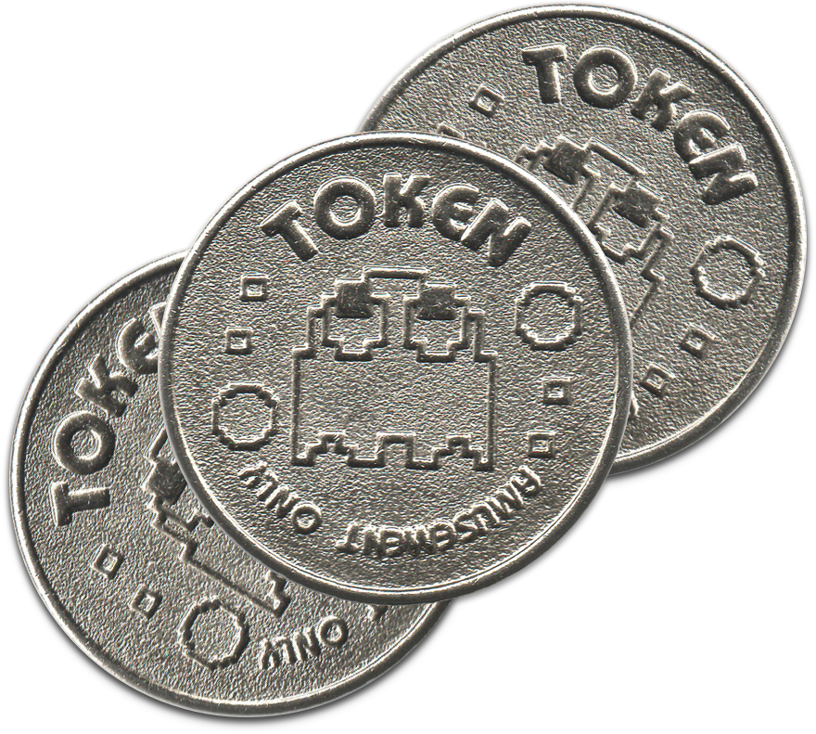

Slide 32
Unique per user session

Slide 33
Unique per user session
Large random value

Slide 34
Unique per user session
Large random value
Generated by a cryptographically secure random number generator

Slide 35
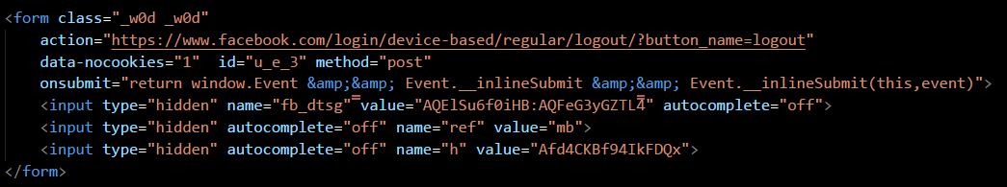

Slide 36
9

Slide 37
9 – Insufficient Logging and Monitoring

Slide 38
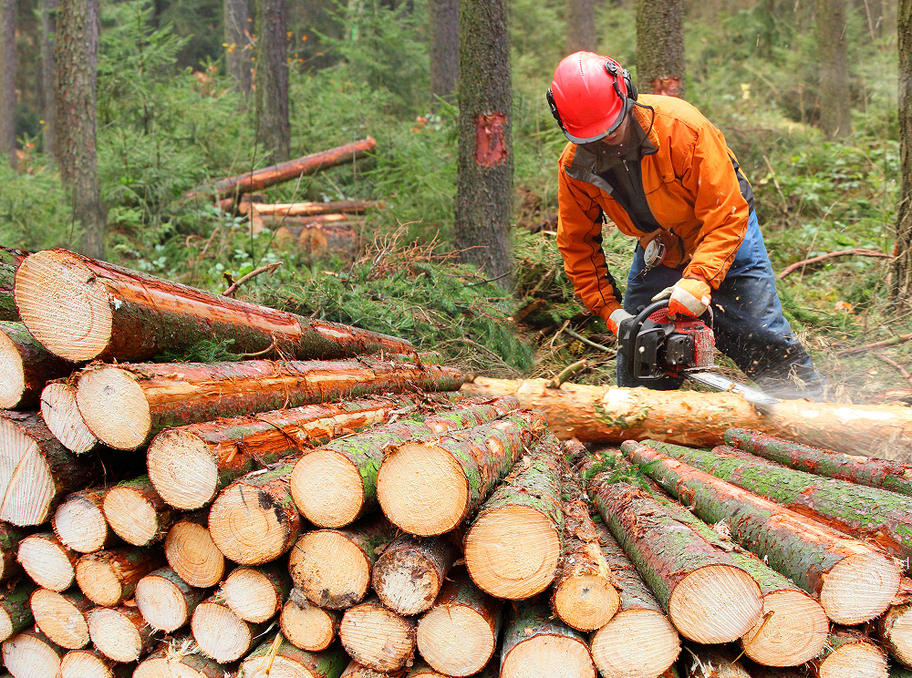

Slide 39
Logins

Slide 40
Logins
It’s called a login for a reason

Slide 41
Transactions

Slide 42
Access Control Failures

Slide 43
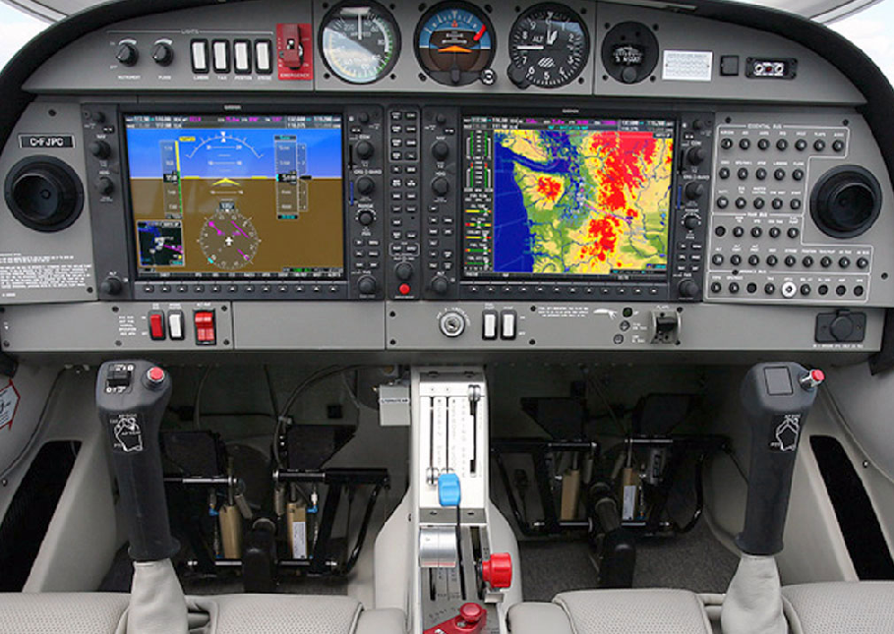

Slide 44
If you don’t log, you’re in a fog

Slide 45
8

Slide 46
8 – Using Components with Known Vulnerabilities

Slide 47
143,000,000
People

Slide 48
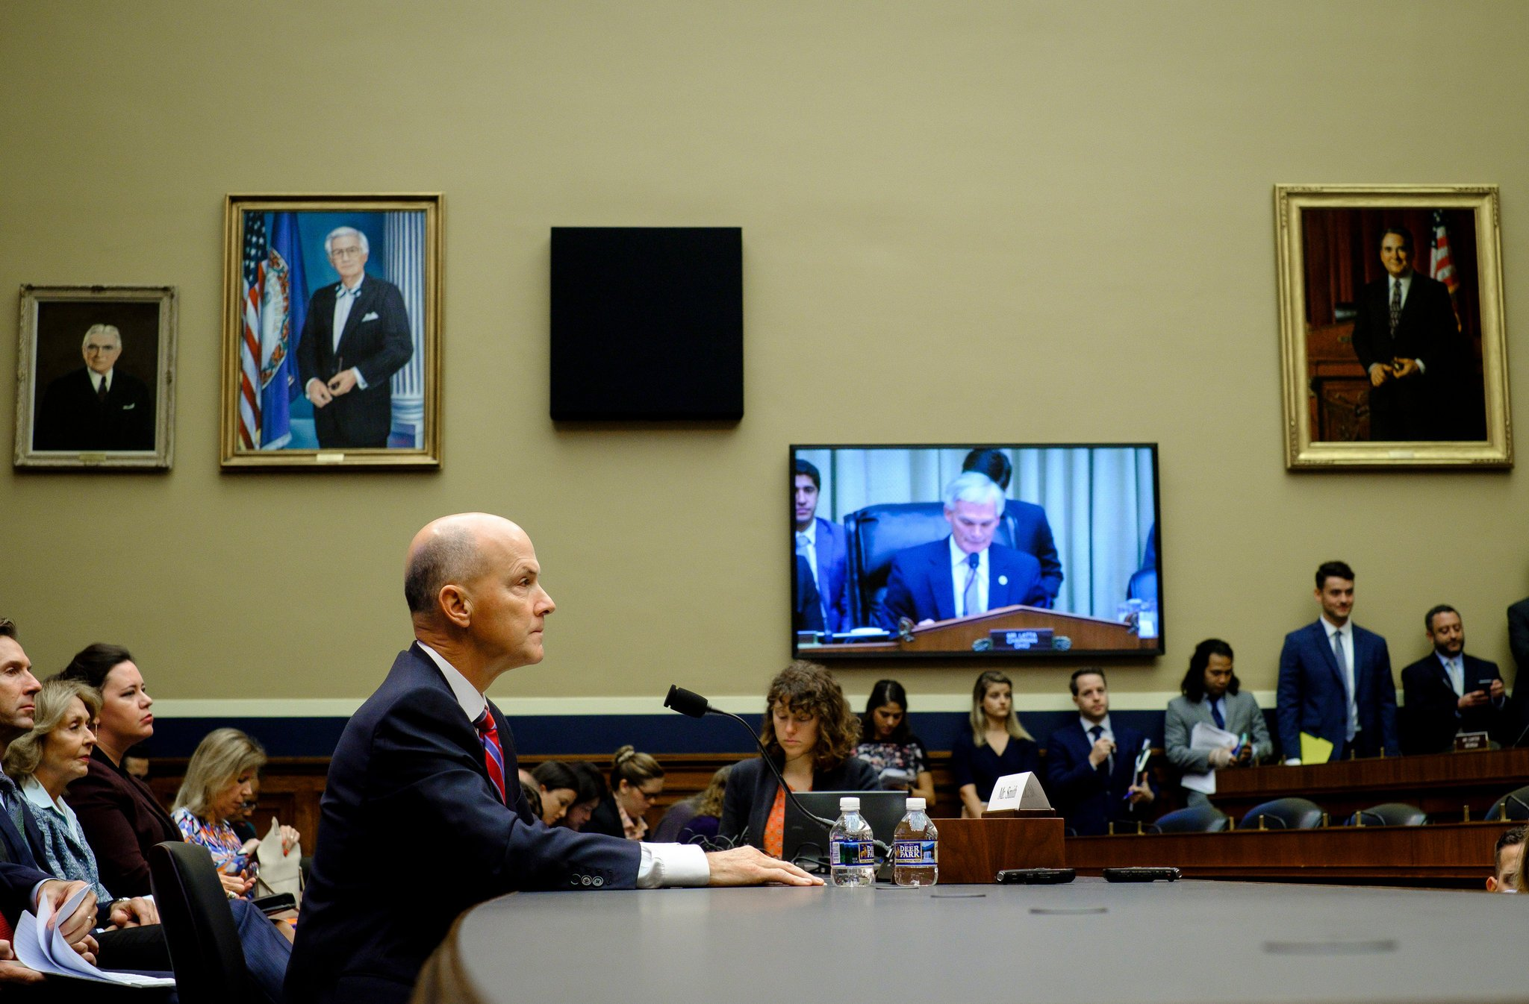

Equifax

Slide 49
Throw it away

Slide 50
Routinely check

Slide 51
7

Slide 52
7 – Insecure Deserialization

Slide 53
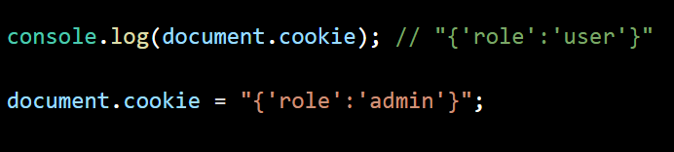

Slide 54
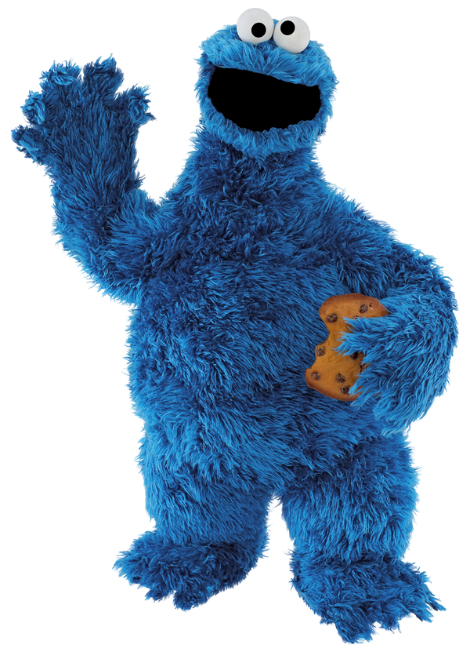
Cookies are a sometimes tool

Slide 55
Integrity Checks

Slide 56
Logging

Slide 57
Avoidance

Slide 58
6

Slide 59
6 – XSS

Slide 60
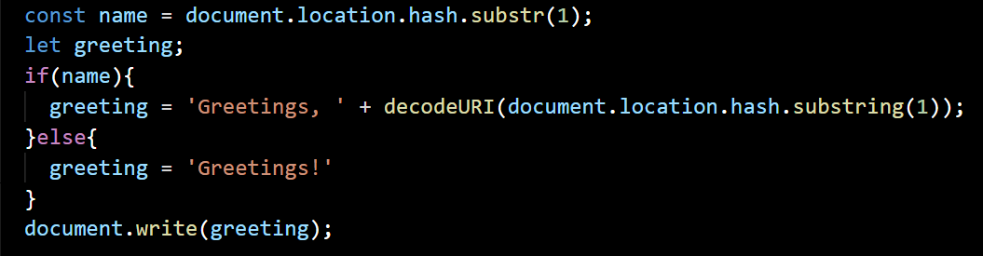
Notes:
const name = document.location.hash.substr(1);
let greeting;
if(name){
greeting = 'Greetings, ' + decodeURI(document.location.hash.substring(1));
}else{
greeting = 'Greetings!'
}
document.write(greeting);

Slide 61
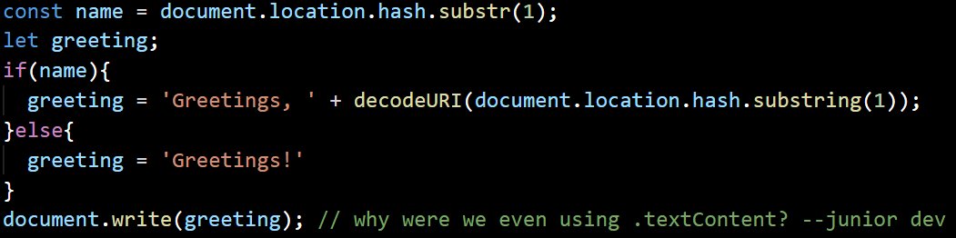
Notes:
const name = document.location.hash.substr(1);
let greeting;
if(name){
greeting = 'Greetings, ' + decodeURI(document.location.hash.substring(1));
}else{
greeting = 'Greetings!'
}
document.write(greeting);

Slide 62
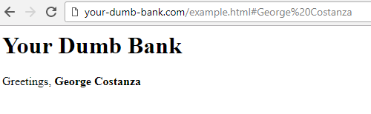

Slide 64
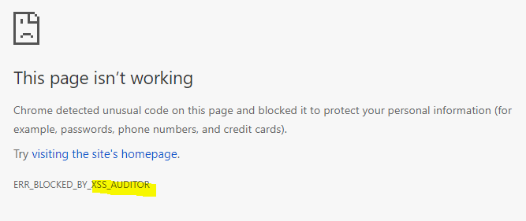
Chrome

Slide 65
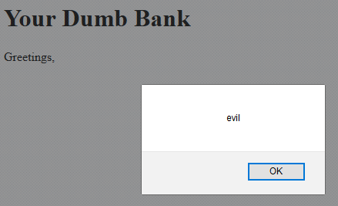
Firefox

Slide 66
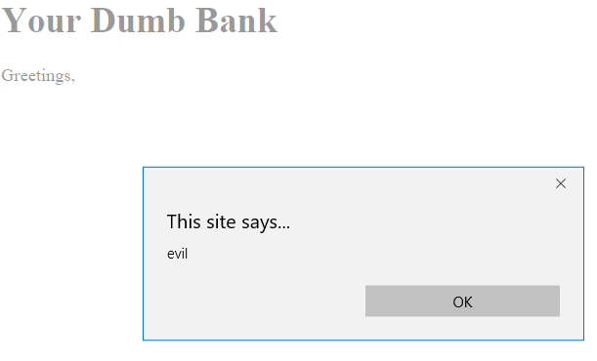
Edge

Slide 67
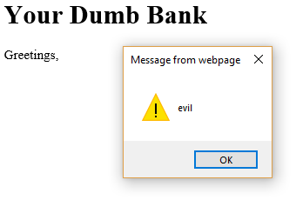
IE

Slide 68
Shocking
IE

Slide 69
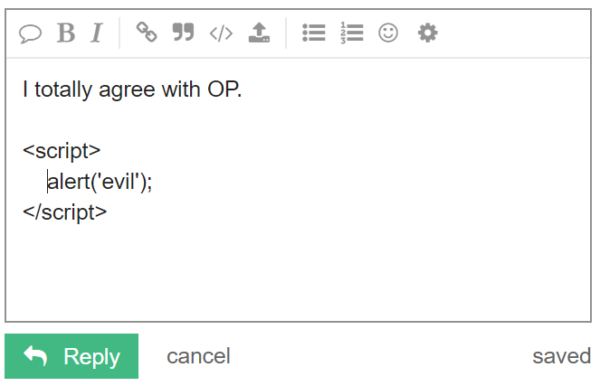

Slide 70
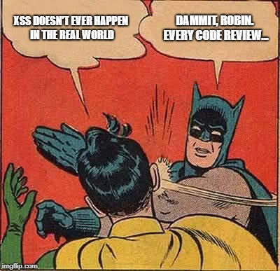

Slide 71
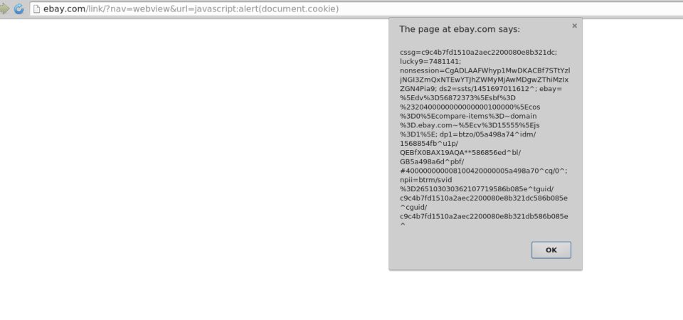
https://ret2libc.wordpress.com/2016/01/11/a-tale-of-ebay-xss-and-shoddy-incident-response/
http://ebay.com/link/?nav=webview&url=javascript:alert(document.cookie)

Slide 72
Trusted Frameworks

Slide 73
Escape Strings

Slide 74

HIGH FIVE

Slide 75
5

Slide 76
5 – Security Misconfiguration

Slide 77
Turn off unnecessary features

Slide 78
Remove unnecessary software

Slide 79
Turn off detailed errors

Slide 80
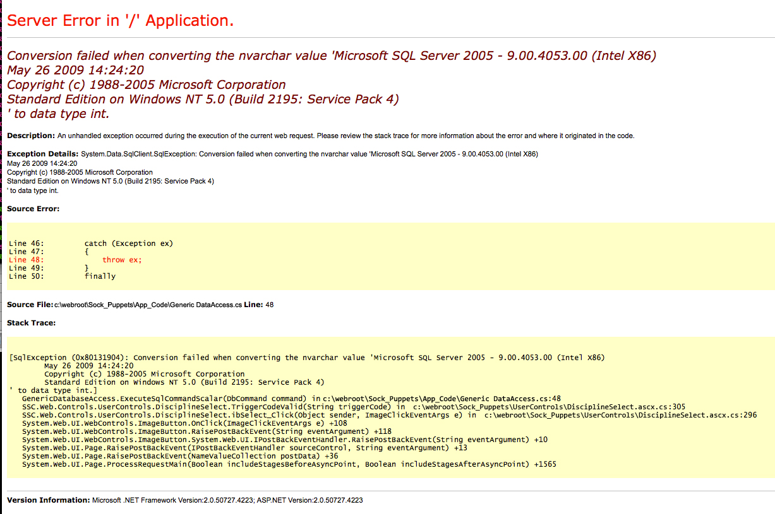

Slide 81
Security through Obscurity is NOT Security

Slide 82
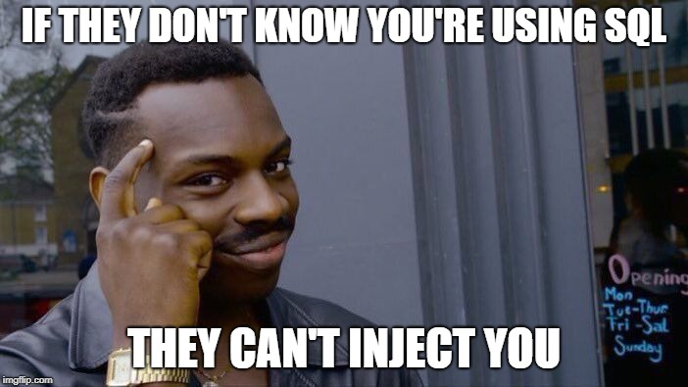

Slide 83
4

Slide 84
4 – Broken Access Control

Slide 85
Prevent Caching

Slide 86
Deny by default

Slide 87
Prevent Path Traversal

Slide 88
3

Slide 89
3 – Sensitive Data Exposure

Slide 90
HTTPS

Slide 91
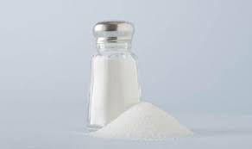
HASH

Slide 92
Username | Salt value | String to be hashed | Hashed value = SHA256 (Password + Salt value)
user1 | E1F53135FAE559C253 | password123+E1F53135E559C253 | 72AE25495A7981C40622D49F9A52E4F1565C90F048F59027BD9C8C8900D5C3D8
user2 | F84B03D034B409D4E | password123+84B03D034B409D4E | B4B6603ABC670967E99C7E7F1389E40CD16E78AD38EB1468EC2AA1E62B8BED3A

Slide 93
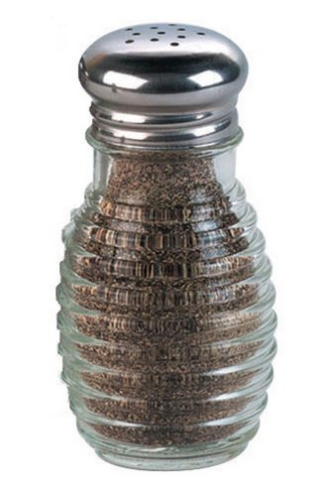

Slide 94
Why did the dinosaurs die?

Slide 95
They tried to create their own encryption

Slide 96
2

Slide 97
2 – Broken Authentication

Slide 98
MF Authentication

Slide 99
No Defaults

Slide 100
Limit failures

Slide 101
Same message for login failures

Slide 102
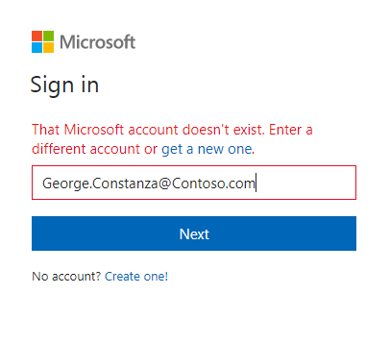

Slide 103
1

Slide 104
1 - Injection

Slide 105
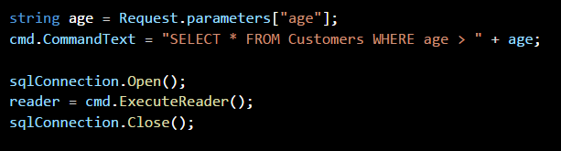

Slide 106
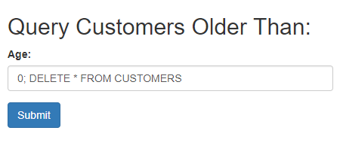

Slide 107
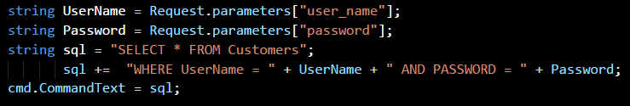

Slide 108
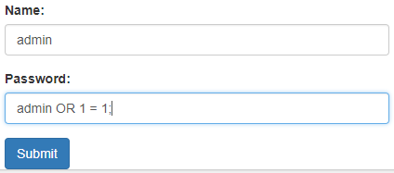

Slide 109
NoSQL?

Slide 110
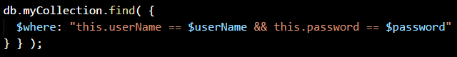

Slide 111
Server-side
validation

Slide 112
Parameterized
Queries

Slide 113
Let’s check back in with Dave

Slide 114
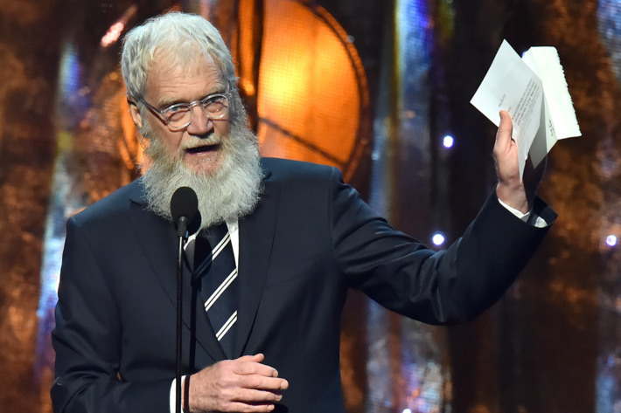

Slide 115
Managing Risks

Slide 116

Any questions?
You can find me at:
@dennythecoder · denny.headrick@gmail.com

